Slide 1
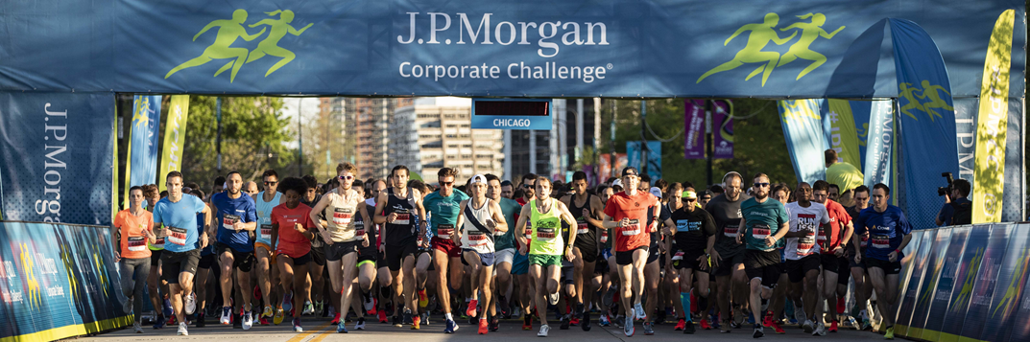
Race for Data
Notes:
an exercise in scraping data, and learning how to create visualizations (like we would usually do in Tableau), in R

Slide 2
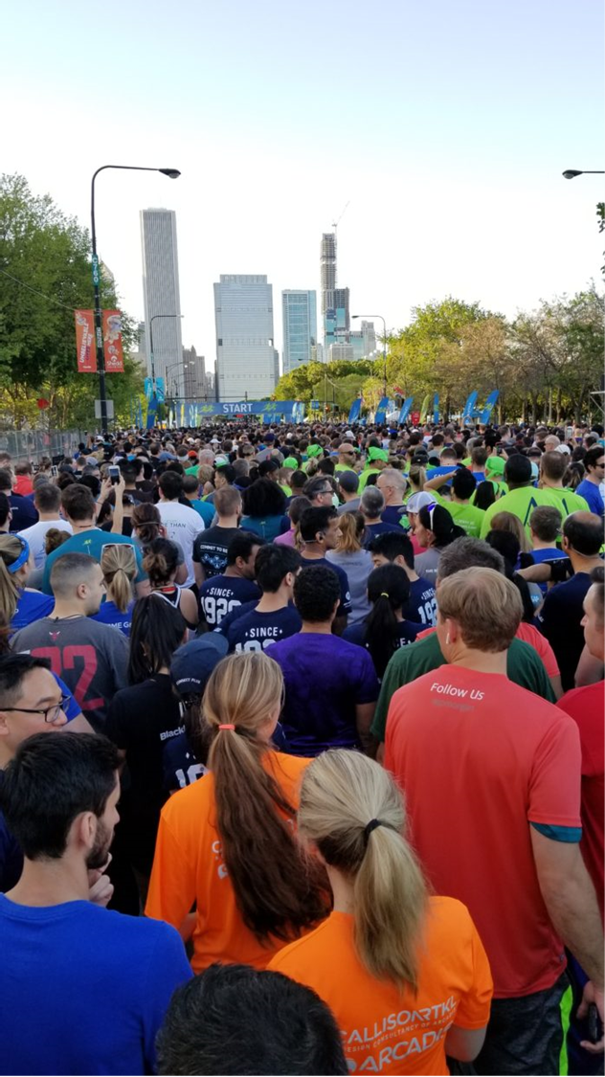
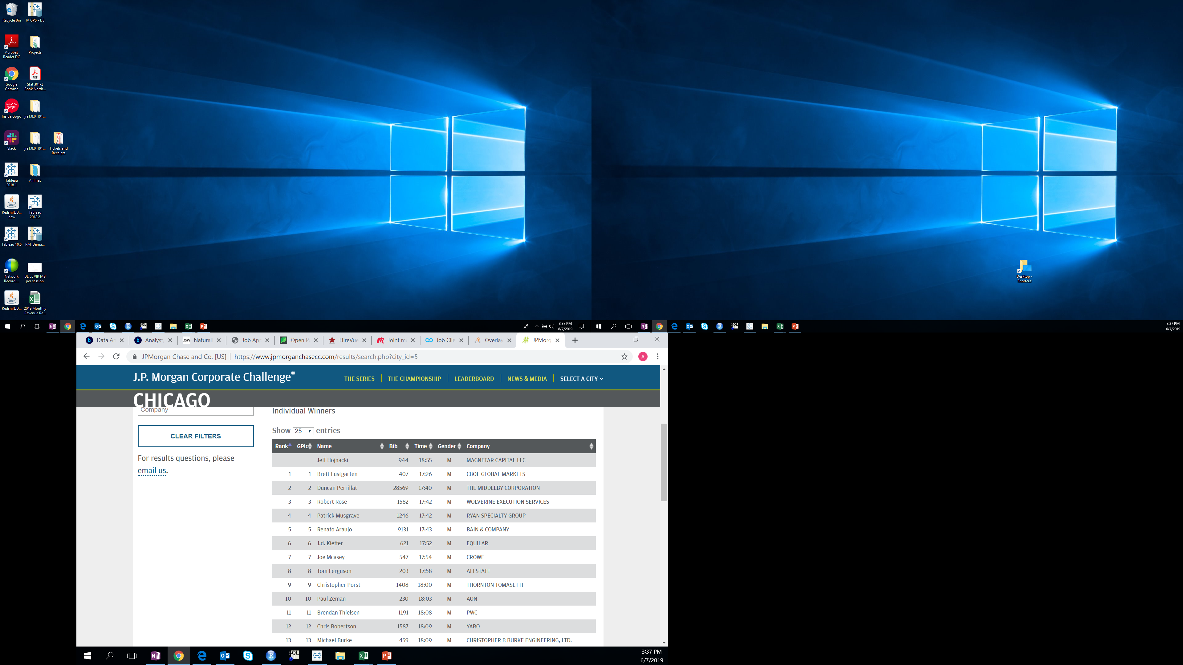
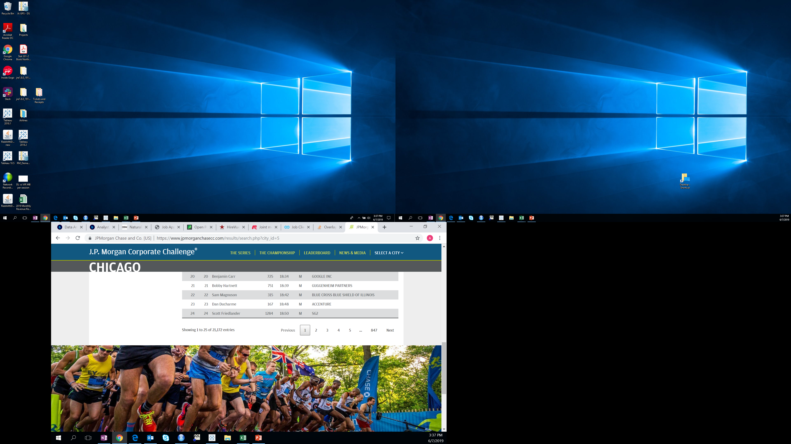

Slide 3
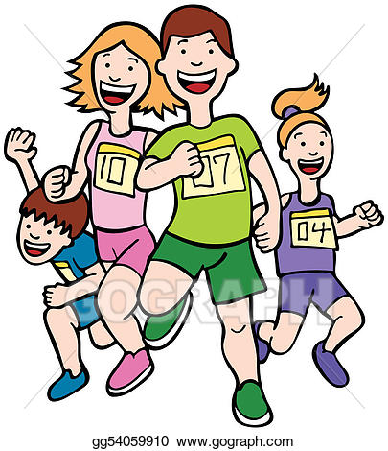
R Code
library(jsonlite)
library(dplyr)
library(tidyr)
library(ggplot)
4 API calls using fromJSON() – one each for 2016, 2017, 2018, 2019
Use rbind() to create one data frame with data for every individual racer for the past 4 years
Notes:
Show data frame

Slide 4
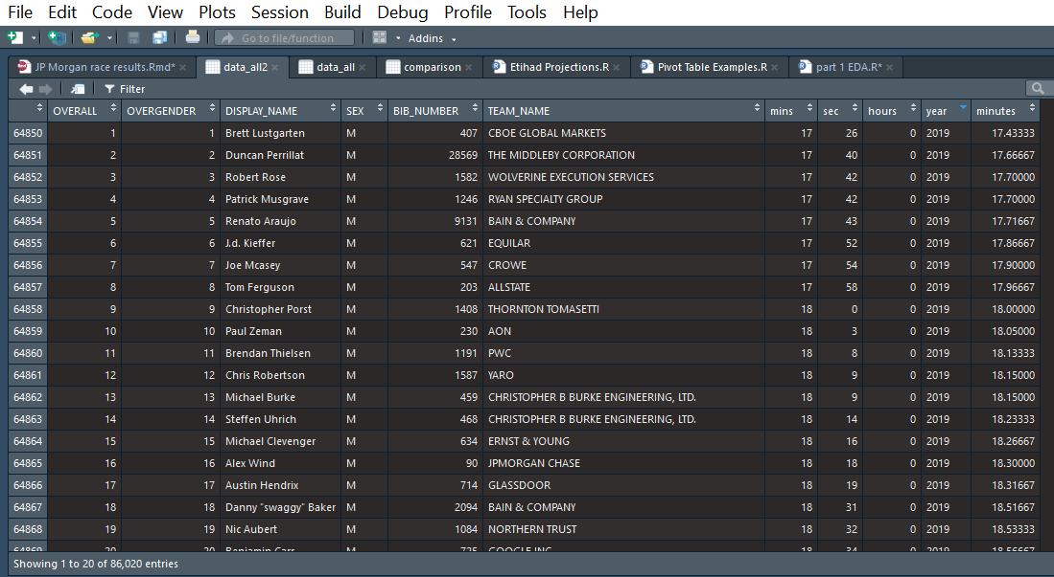

Slide 5
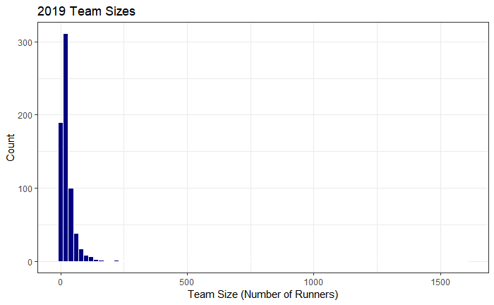
Racer Stats
21,171 total racers in 2019
685 companies participated
Average team size is 31 people
Median team size is 18 people
Notes:
Plot 6

Slide 6
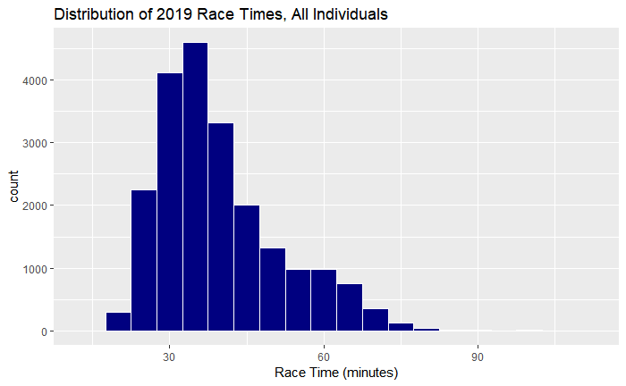
Notes:
Plot1 – average 2019 race time = 40 minutes

Slide 7
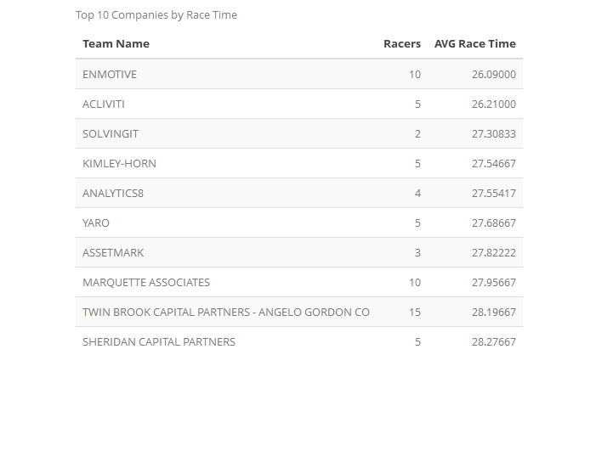
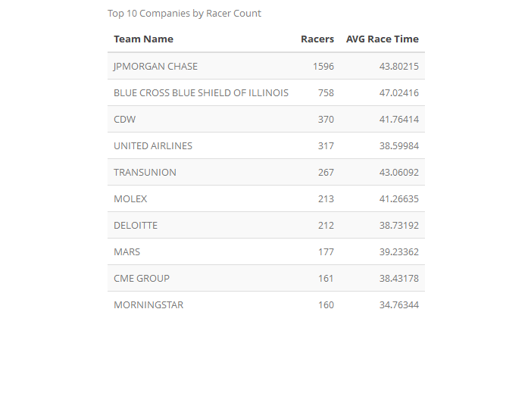

Slide 8
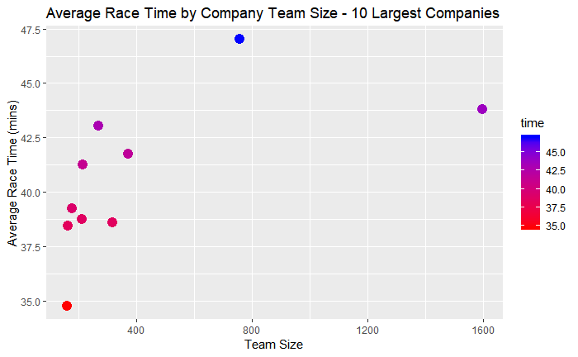
Notes:
P7000 –Top 15 companies by shortest race time have 15 or fewer runners

Slide 9
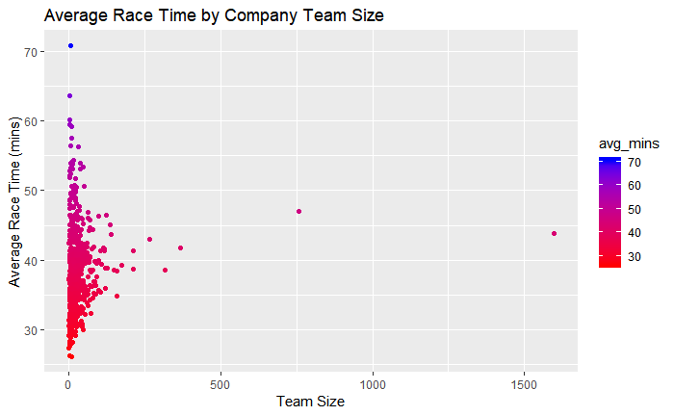
Notes:
p700

Slide 10
Year Over year comparisons

Slide 11
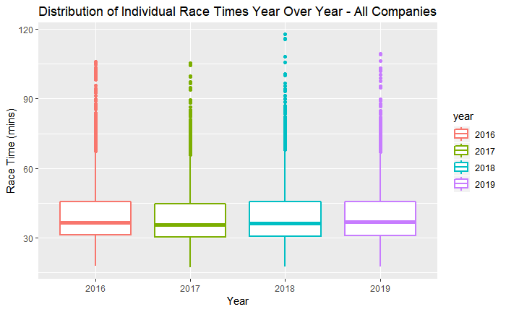
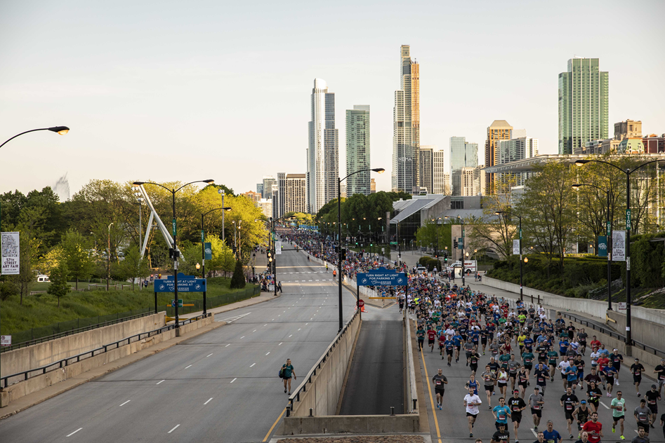
4 Years of Race Data
Notes:
Plot4

Slide 12
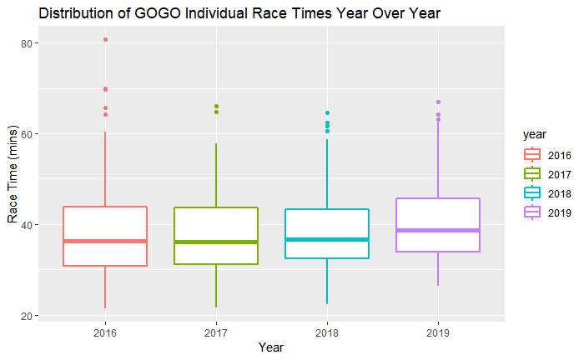
Gogo Race Times Year Over Year
Notes:
p14

Slide 13
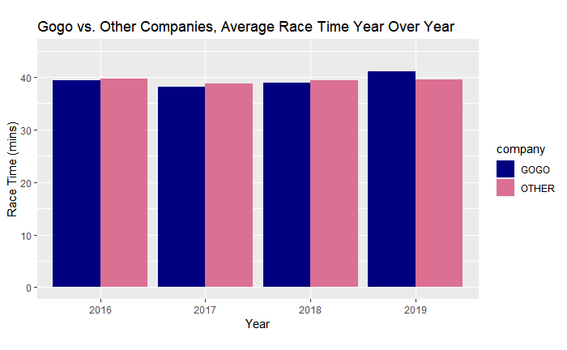
Average Race Time Year Over Year – All Companies
Notes:
Plot comp – change in lanes (walk vs. run) after 2017!

Slide 14
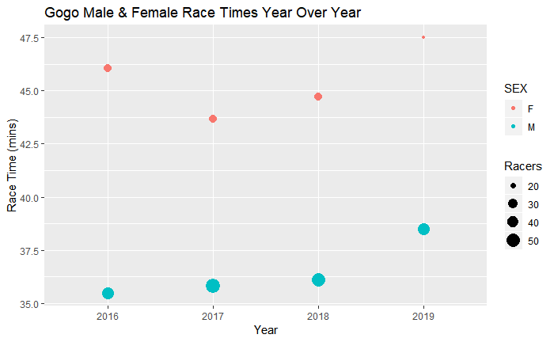
Male & Female Race Times YoY
Average Female Time for Gogo in 2019 was 47.5 mins (18 runners)
Average Male Time for Gogo in 2019 was 38.5 mins (44 runners)
Notes:
Males got consistently worse YOY – look at that increase in avg time from 2016 to 2019!! Let’s dig into this!

Slide 15
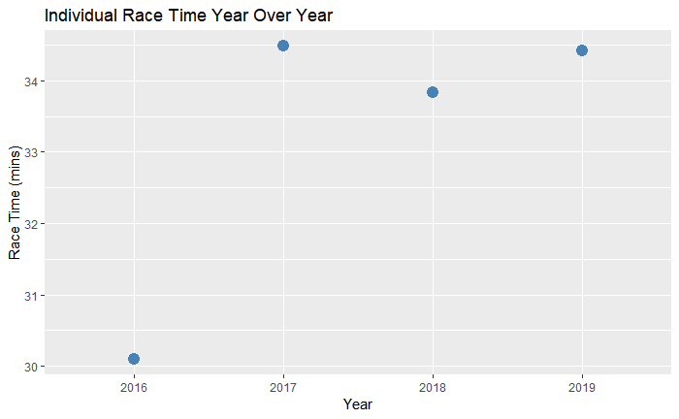
A Gogo Individual’s Race Time YoY
Notes:
This is one male individual’s race results – look at that trend we saw before, from 2016 to 2018 and 2019 – huge increase. Let’s ask the culprit what happened!

Slide 16

Notes:
Trent? What happened? Any input on why times got slower over the past two years? (WALKERS vs RUNNERS organization?)

Slide 17
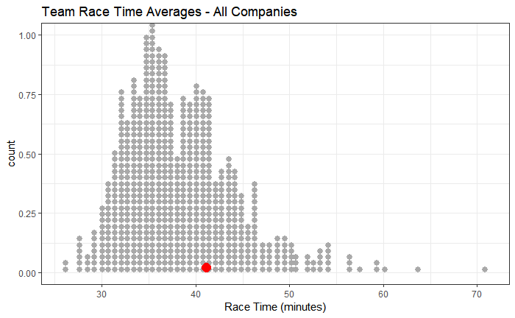
Gogo Average Race Time vs All Companies
63 (10%) of companies have less than 5 runners
190 (28%) of companies have 10 or fewer runners
Notes:
Top 15 companies by shortest race time have 15 or fewer runners

Slide 18
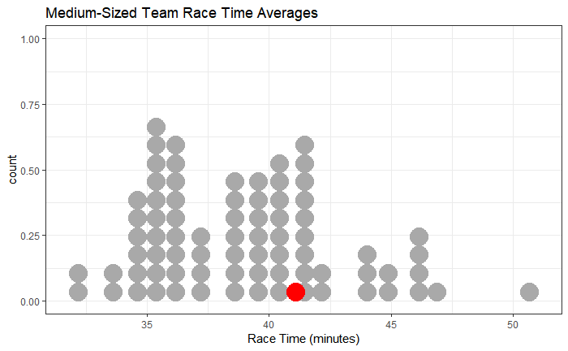
Gogo Average Race Time vs. Companies in Same Team Size group

Slide 19
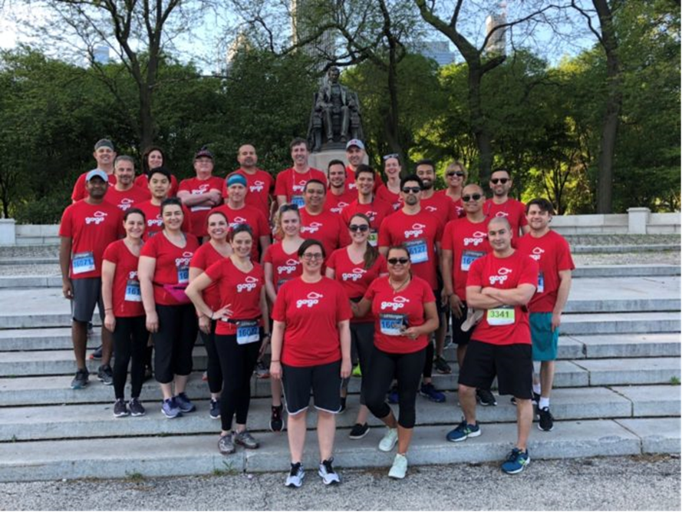
Race for Data Takeaways
Plotting in R is easy! Can easily change variables and rerun code to reproduce plots quickly
Gogo runners need to train harder for next year’s race!
Notes:
Here is something I did in R that would have taken about the same amount of time in Tableau. easily change data source or filter data source or change variable name instead of reapplying filters over and over

